Slide 1

IWSS
Intelligent Wafer Sorting System
Mighty Prober Technology
Wafer Mapping System
IWSS
Intelligent Wafer Sorting System

Slide 2
Design Philosophy
Windows 11 ® operating system
SQL database design to allow client company to create / access their own data
IWSS program to collect data during the probing process
IWSS Report program for data analysis at your desktop
Take advantage of the computer tools available in the windows environment to simplify all user operations in the package
Utilize the internet and standard internet formats whenever possible
Take advantage of years of probing and mapping experience to provide the best productivity features
IWSS
Intelligent Wafer Sorting System

Slide 3
Database Features
SQL Server
  Open concept
    Client company has complete access to all database functions
    Custom reports
  Edit / modify maps and map data
Password protection of database
Menu Structure
Menus are laid out intelligently and easy to navigate
Enhancements simplify the setup and use of the system
Intuitive design takes advantage of known Icons and computer user procedures
IWSS
Intelligent Wafer Sorting System

Slide 4
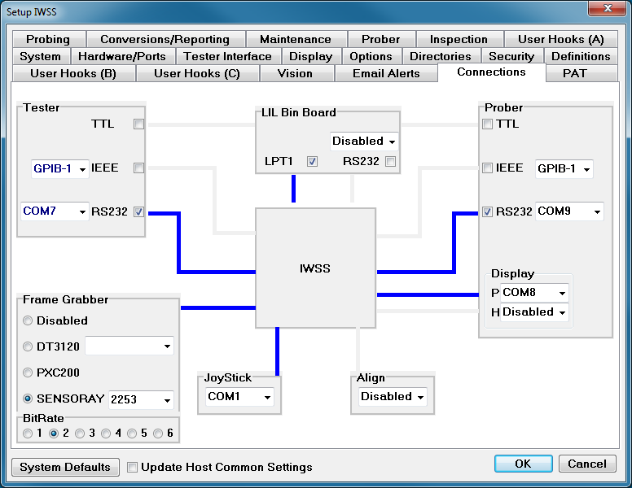
Connection Tab
Graphically displays the connections between IWSS, the tester and the prober.
IWSS
Intelligent Wafer Sorting System

Slide 5
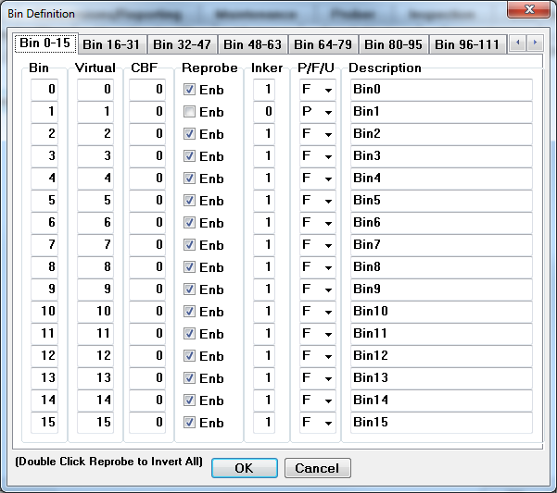
Bin Definition Setup
Bins can be defined as Pass, Fail or Undefined
IWSS
Intelligent Wafer Sorting System

Slide 6
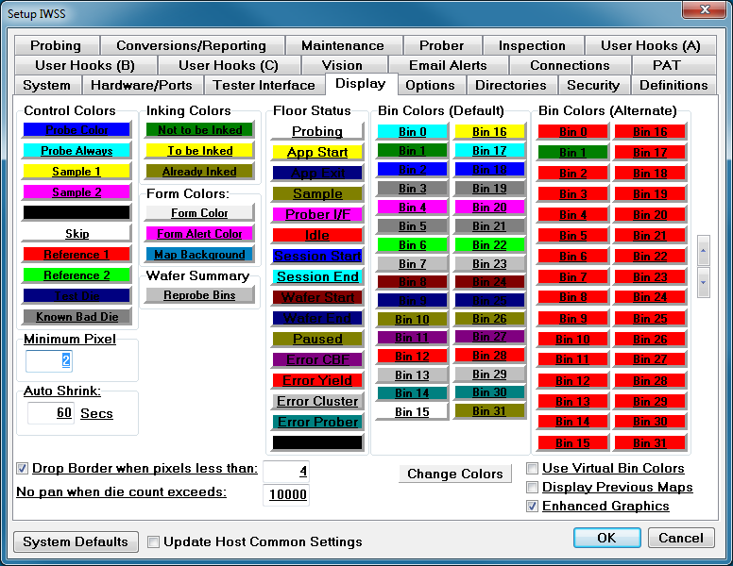
Color Selection
User defined colors make map display more meaningful
IWSS
Intelligent Wafer Sorting System

Slide 7
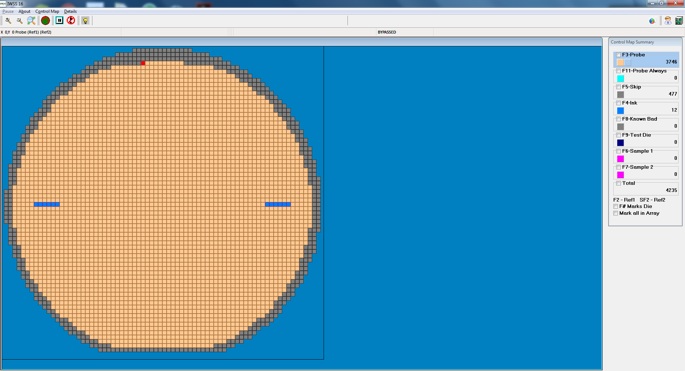
Control Map Basics
Define probe, skip, ink and sample die
2 tier sample probing with “probe always” die
640,000 die capable (10 mil X 10 mil die on a 200mm wafer)
Camera and pattern recognition routine to automatically create control maps.
Once the control map is built automatically, the user can edit it easily from the desk top or the prober.
IWSS
Intelligent Wafer Sorting System

Slide 8
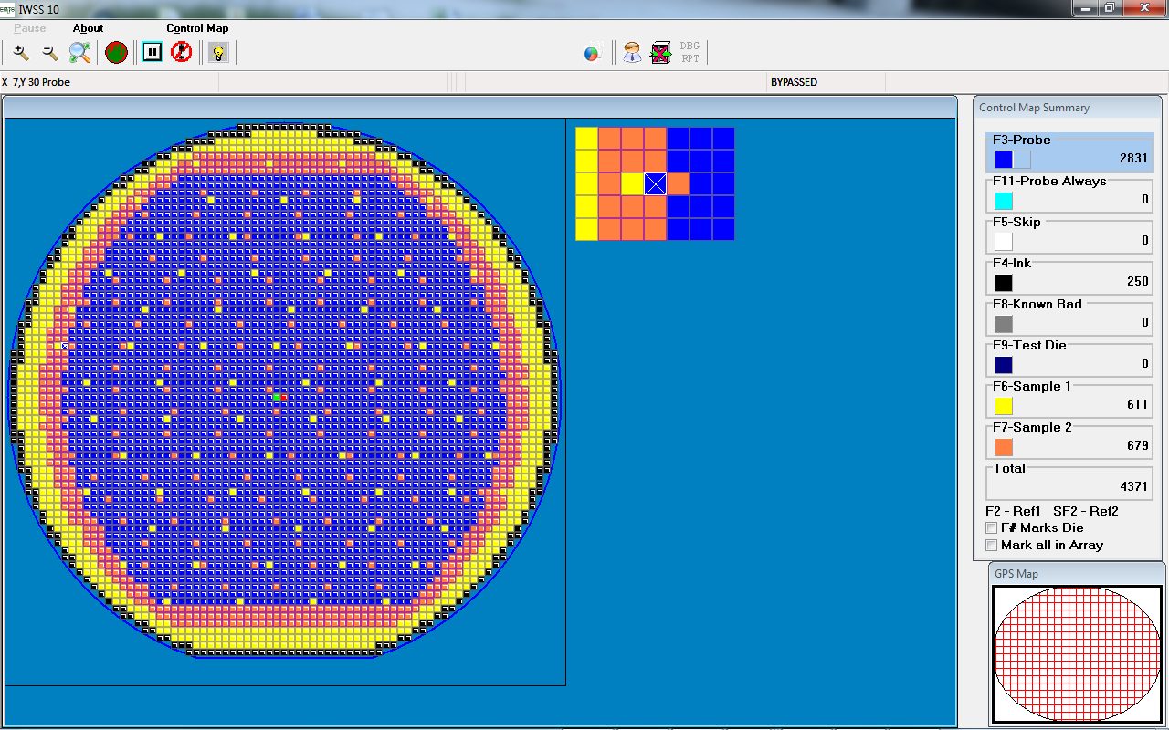
Control Map with Sample probe defined
IWSS
Intelligent Wafer Sorting System

Slide 9
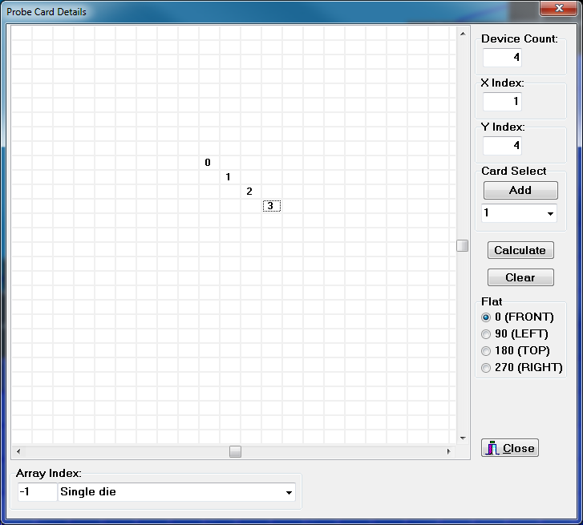
Control Map Features
CCD Camera and pattern recognition algorithms build control maps automatically.
User definable multi die arrays
64 Die maximum for multi die arrays
Up to 10 multi die arrays are assignable in each control map.
Link composite map to control map for convenient die marking
User Specified Multi Die Array
The user may define a multi die array that will be used for probing. This array is used by IWSS to assign the bin code to the correct die location. Please note that it also defines the order in which the die test results will be assigned.
IWSS
Intelligent Wafer Sorting System

Slide 10
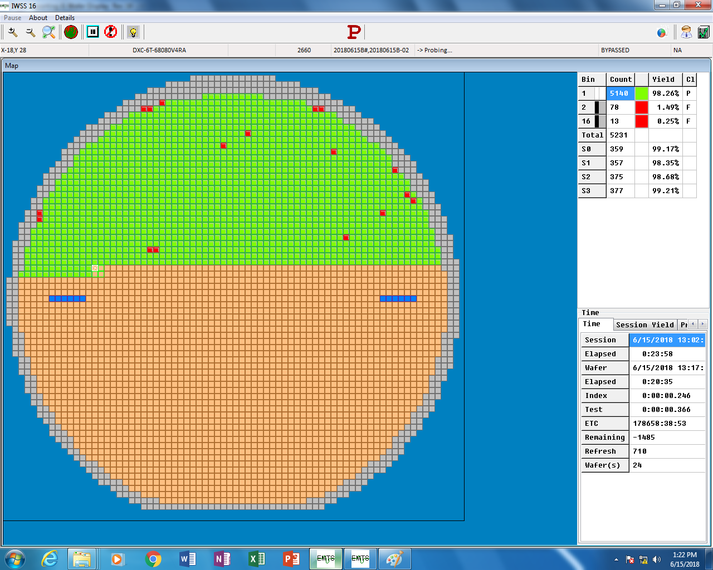
Wafer Map
Real time display
Shows statistics and updates
1 million colors available
Screen snaps of active probers available via the internet for authorized users
Bin / Yield monitors and alarms
Real Time Display
IWSS
Intelligent Wafer Sorting System

Slide 11
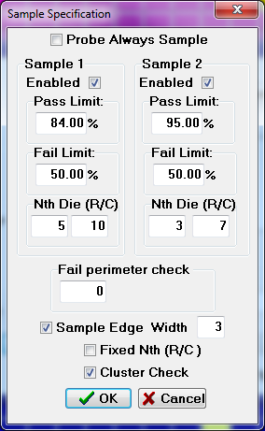

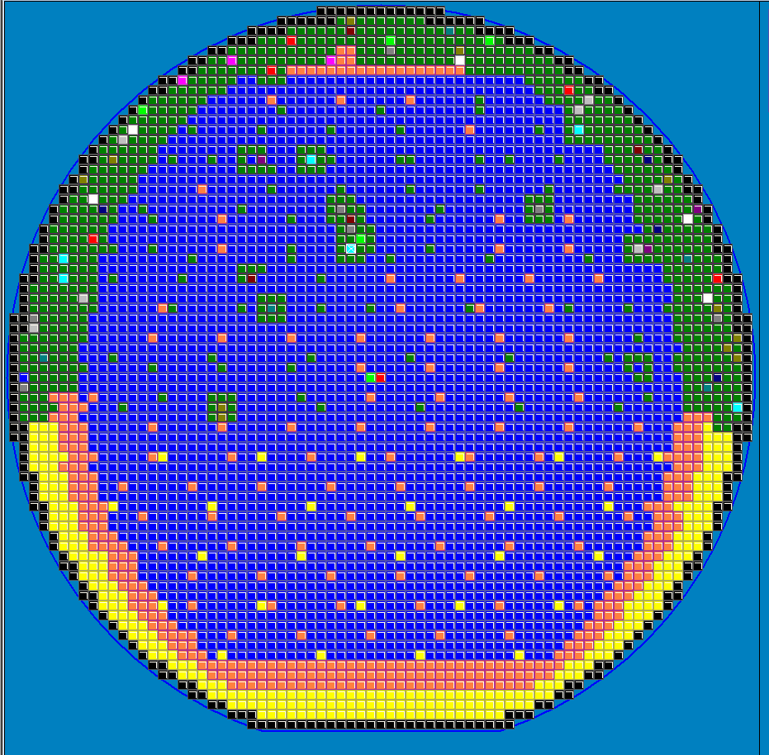
Wafer Map
2 tier sample probe with cluster check (Smart Probe) to perform automatic test of surrounding failed sample devices.
Cluster Check tests surrounding devices until the failures are surrounded by passing devices
IWSS
Intelligent Wafer Sorting System

Slide 12
Interfacing
Software Compatibility
Compatible with Electroglas Sortnet ® format
Array format conversion available
Open database structure allows client company to create their own output files and file formats
Standard package will include NAM file format
Setup file structure that will accommodate EG 2000 and 4000 series probers.
Accommodate tester interface via RS 232, TTL or IEEE 488
IEEE 488 interface through integrated National Instruments HS-USB
IWSS
Intelligent Wafer Sorting System

Slide 13
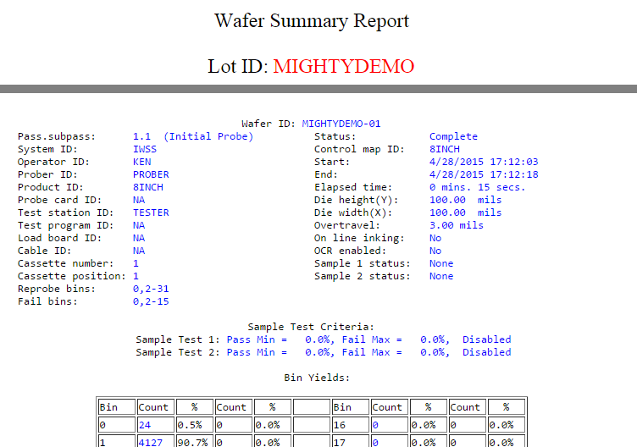
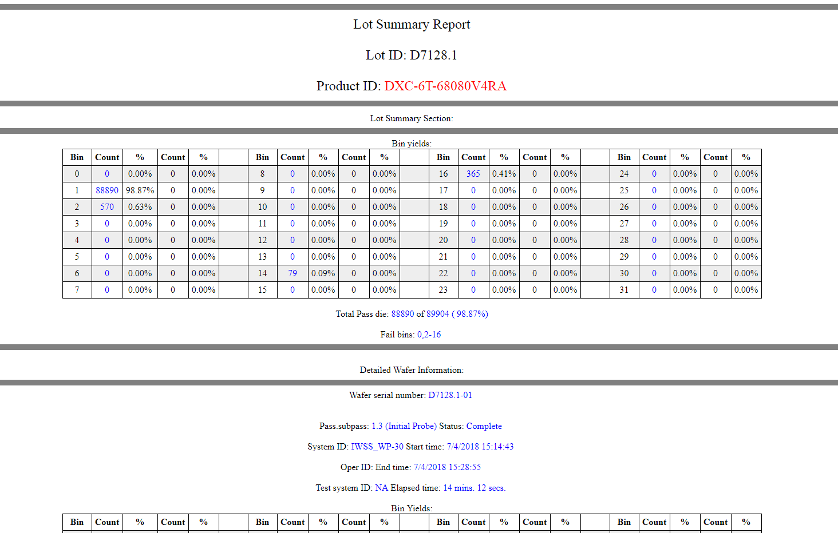
Reports
Standard reports can be created automatically
User defined reports can be created automatically as well
IWSS
Intelligent Wafer Sorting System

Slide 14
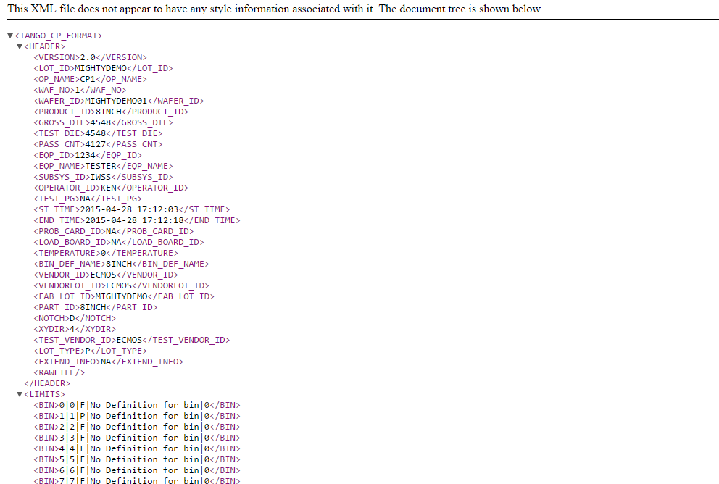
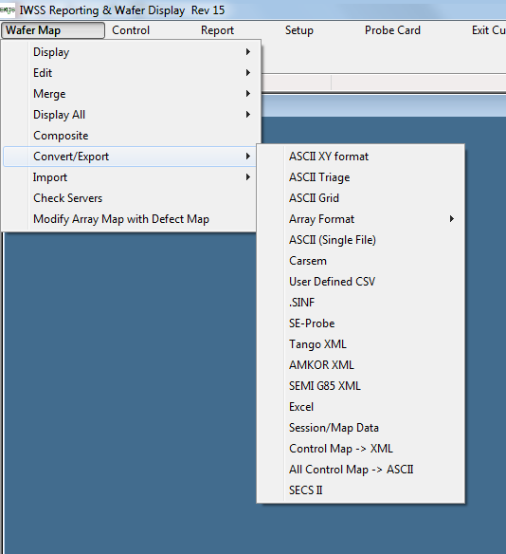
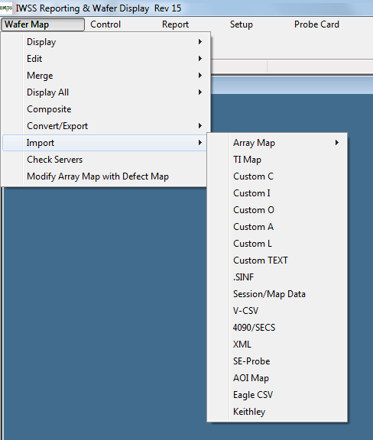
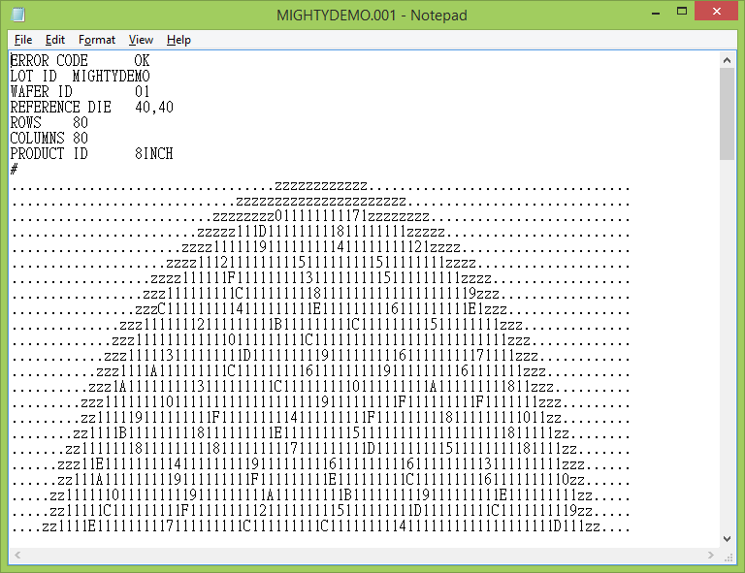
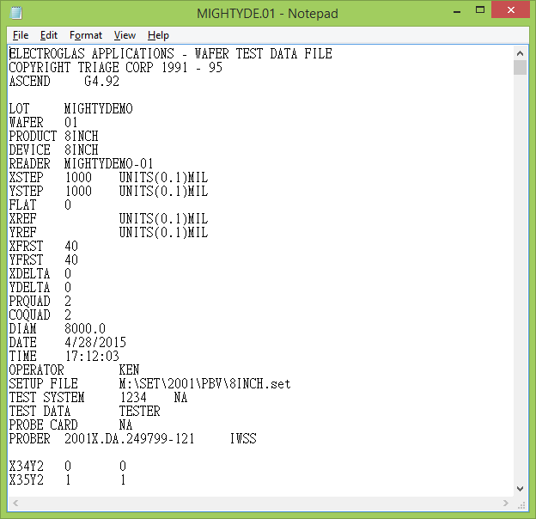
Wafer Map (E-Map) Import/Export
Support multiple formats for import and export
Support customize formats
IWSS
Intelligent Wafer Sorting System

Slide 15
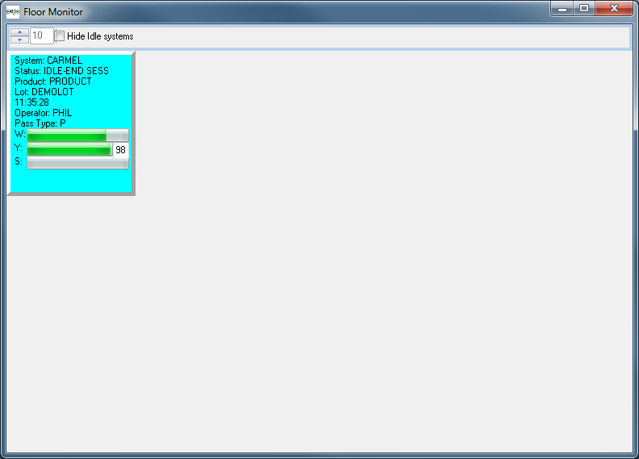
Floor Monitor
Floor monitor shows the status of all IWSS probers on your floor. Bar graph shows progress and yield information.
Image to the left shows a single system. There will be one square for each system monitored.
IWSS
Intelligent Wafer Sorting System

Slide 16
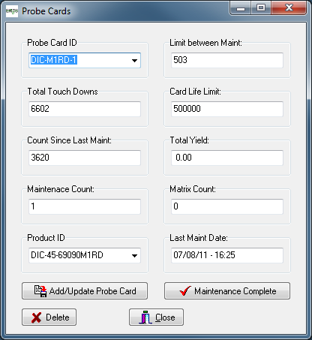
Probe Card Tracking/Maintenance
The Probe Card Tracking feature within IWSS is a comprehensive monitoring and maintenance management system. Its primary objective is to track the lifespan, maintenance history, and the impact of probe cards on test quality.
Total Touch Downs
Count Since Last Maintenance
Maintenance Count
Yield & Productivity Tracking
Card Life Limit
Expiration Alerts
Production Interlock
IWSS
Intelligent Wafer Sorting System

Slide 17
Thank you
IWSS
Intelligent Wafer Sorting System

